Slide 1

Chơi đê ae

Slide 2
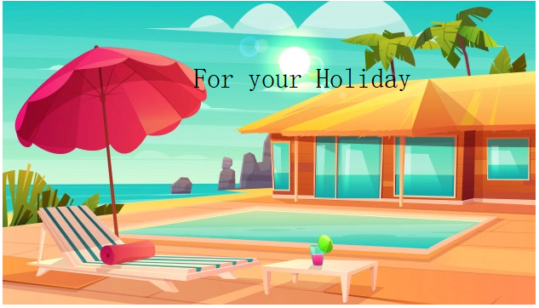
Holiday Resort
A place where lots of people go to for holiday

Slide 3
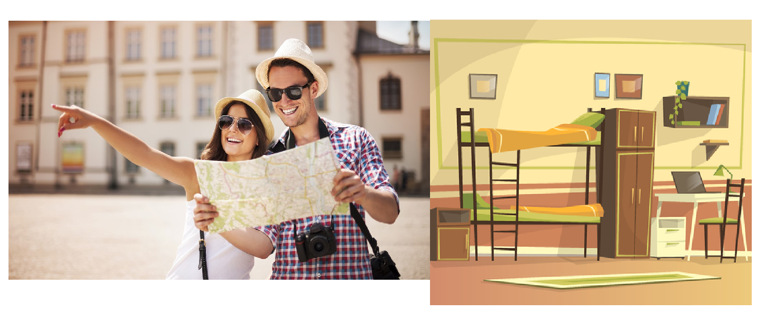
Youth hostel
A cheap form of accommodation

Slide 4
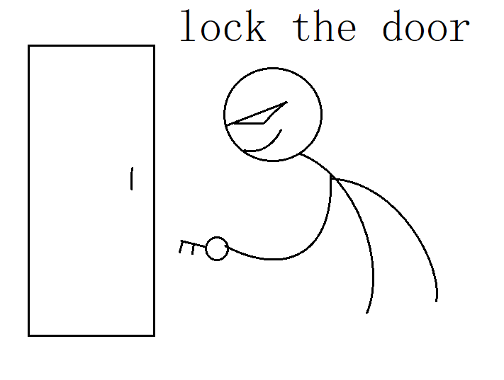
Breathtaking view
Lock a door so that sb can not get out or in

Slide 5
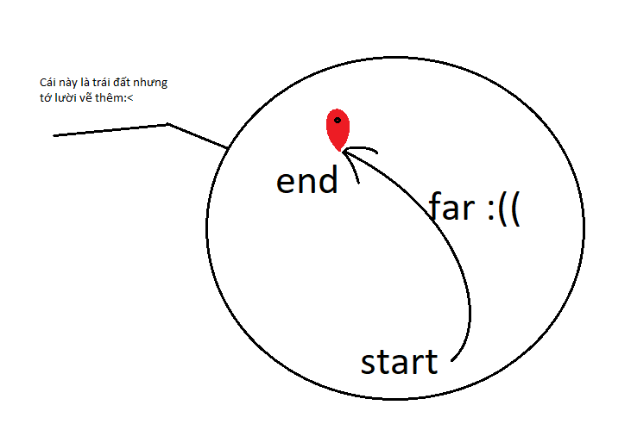
Far-off destination
Somewhere a long way away

Slide 6
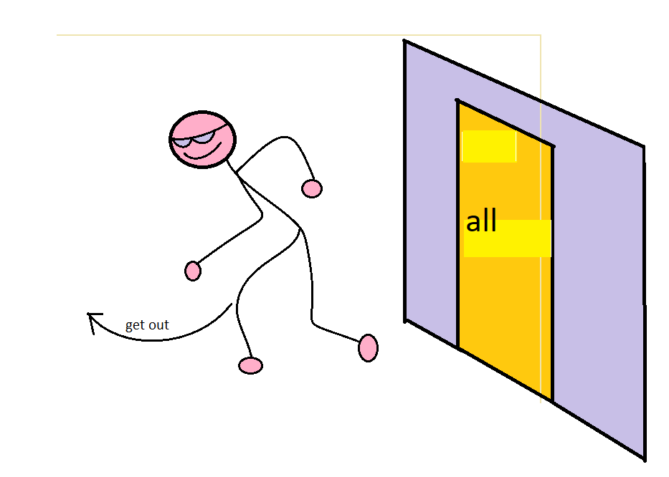
get away from it all
to take a holiday to escape a busy or stressful sifestyle

Slide 7
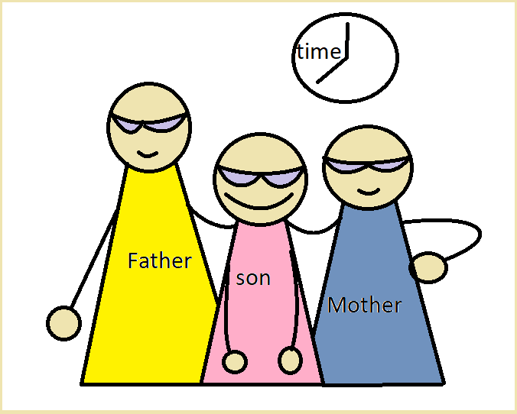
Spend quality time with family
Have a good time with family

Slide 8
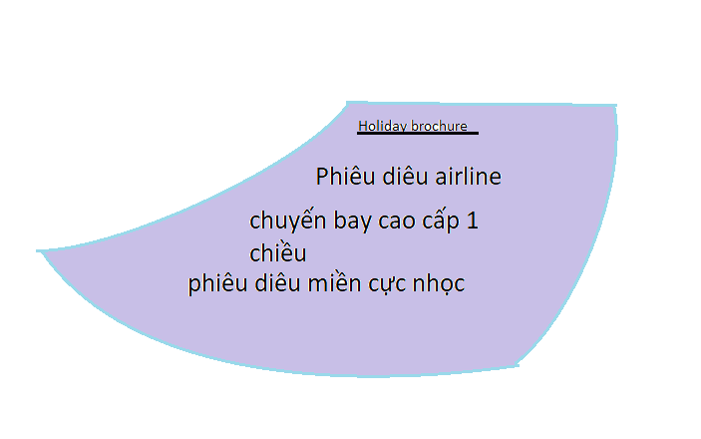
Holiday Brochure
A glossy piblication with details of holiday packages

Slide 9

Holiday destination
Where you go for holiday

Slide 10
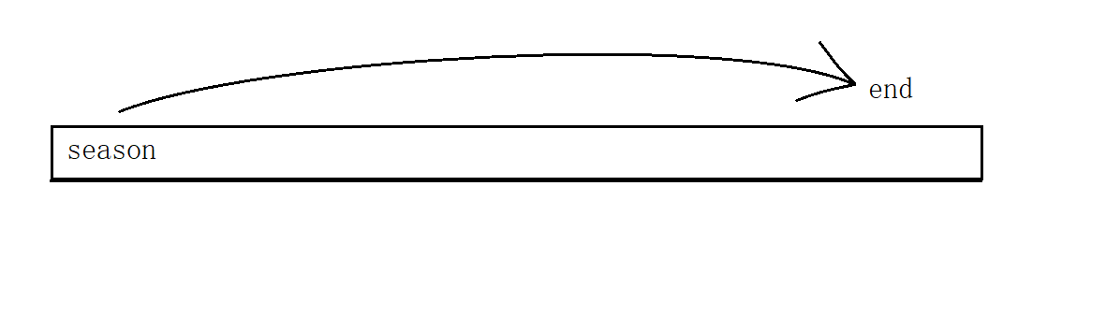
Out of season
Outside of the main holiday period

Slide 11
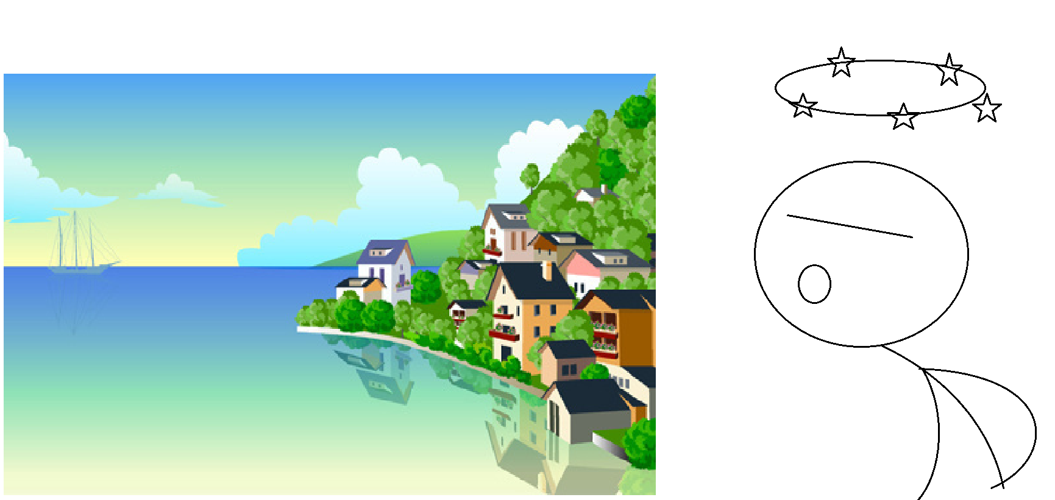
Stunning landscape
Extremely beautiful of attractive countryside

Slide 12
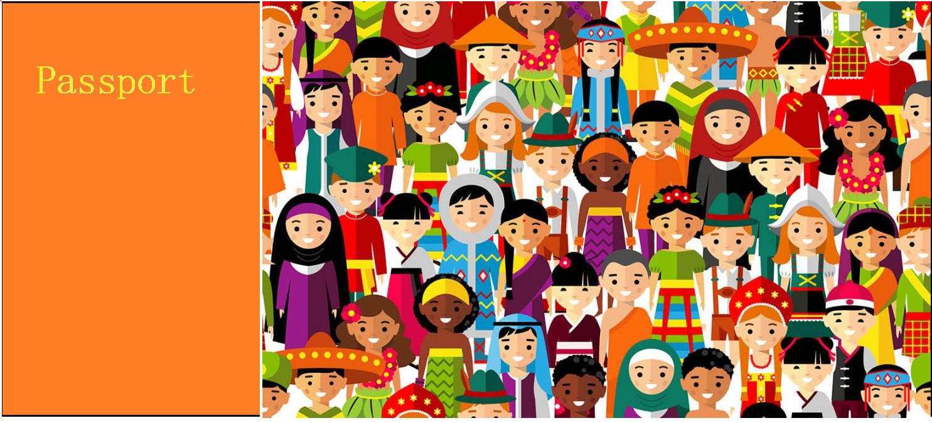
Passport culture
The place where your passport s checked

Slide 13
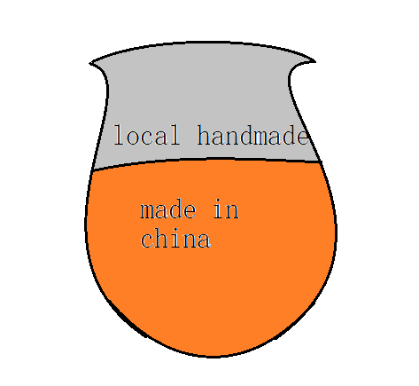
local craft
Objects produced locally

Slide 14

Picturesque village
Very pretty village

Slide 15
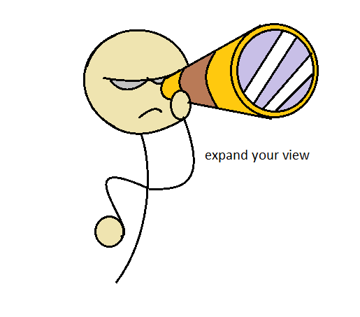
Broaden your horizons
Expand one's range of interests, activities

Slide 16
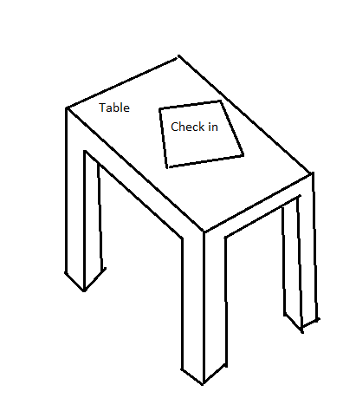
Check-in desk
the place at the airport where you register for your flight and deposit your luggage

Slide 17

Chance to unwind
relax

Slide 18
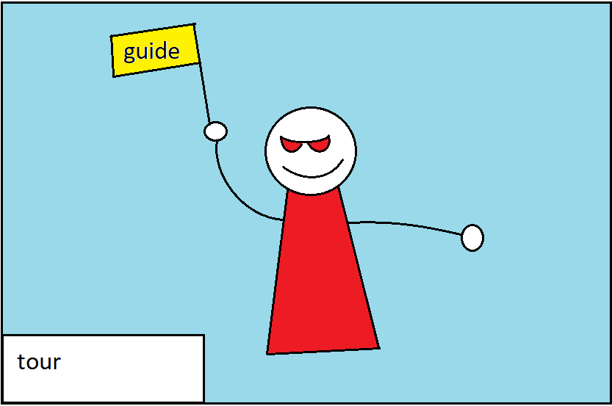
Guided tour
an organized group shown around a place of interest by an expect

Slide 19

Tourist trap
Somewhere where many tourist go

Slide 20
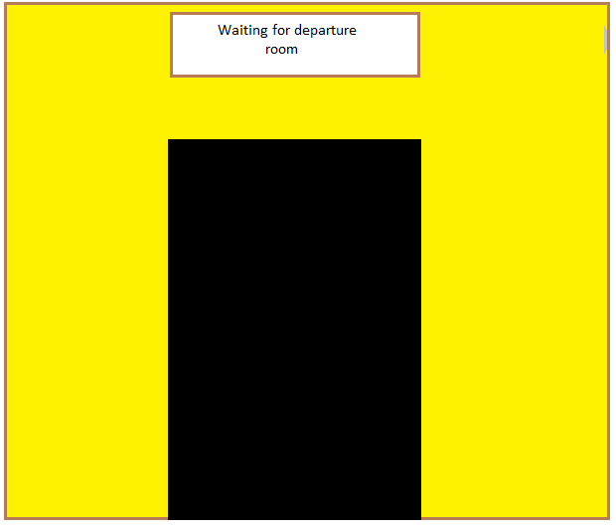
Departure lounge
Where u wait for your flight to be called

Slide 21
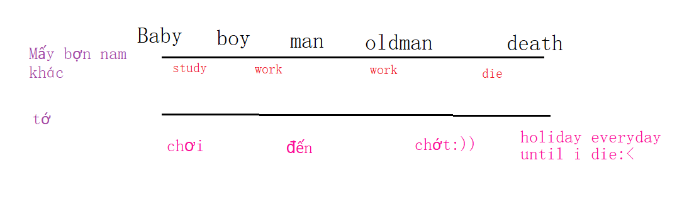
Holiday of a lifetime
a special holiday that you are unlikely to repeat

Slide 22
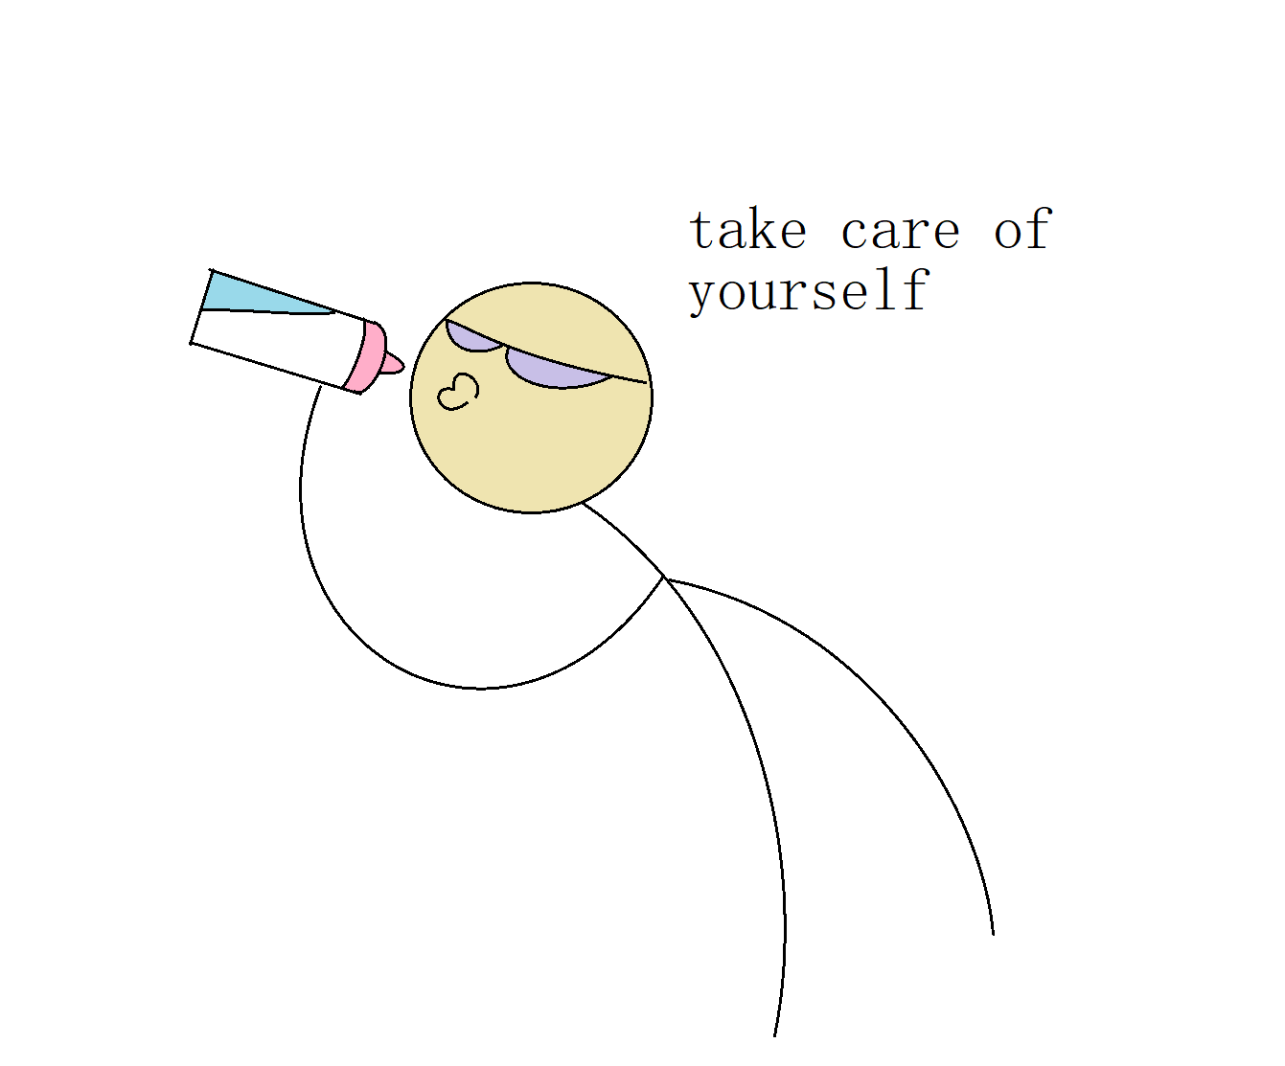
Self-catering
a holiday where you supply your ơn food

Slide 23
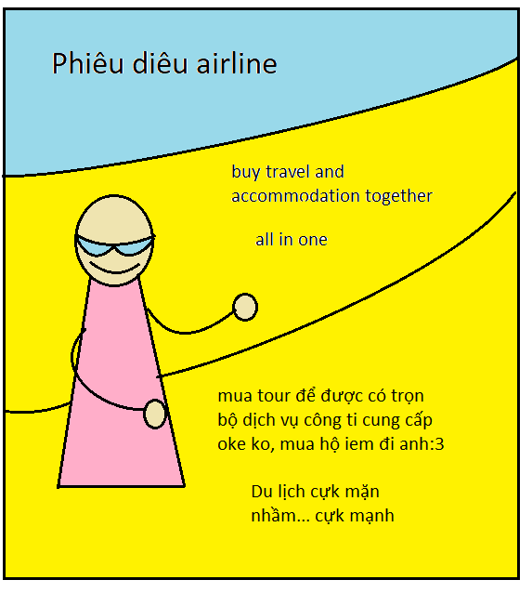
All-in package
A holiday where you prchase the travel and accommodation together

Slide 24
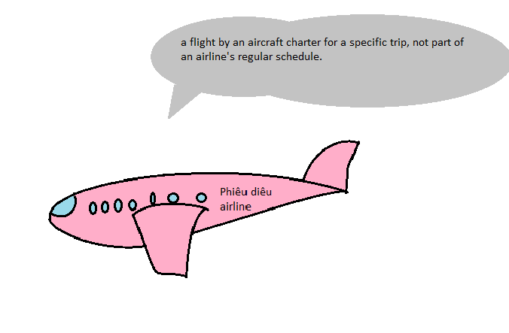
charter-flight
a cheaper form of flying than a scheduled flight

Slide 25
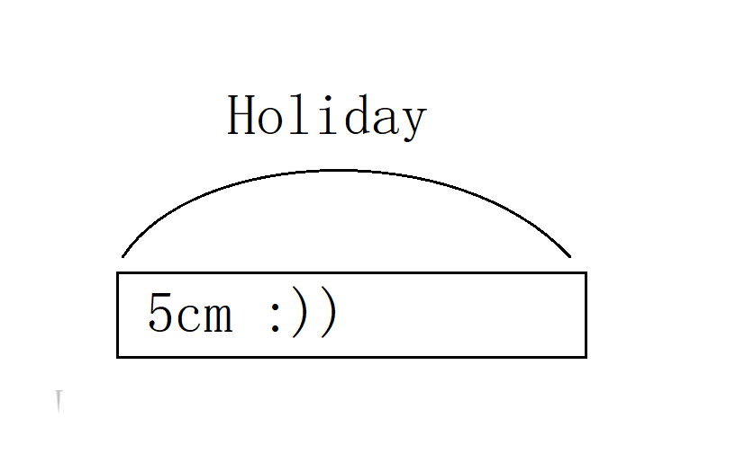
Short Break
A short holiday

Slide 26
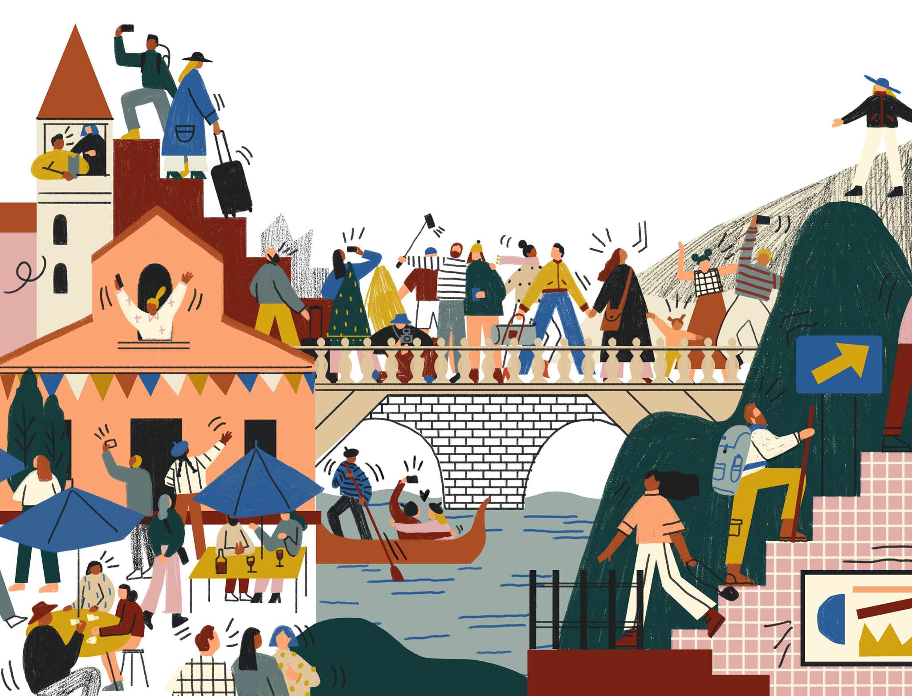
Hordes of tourist
Crowds of tourist

Slide 27
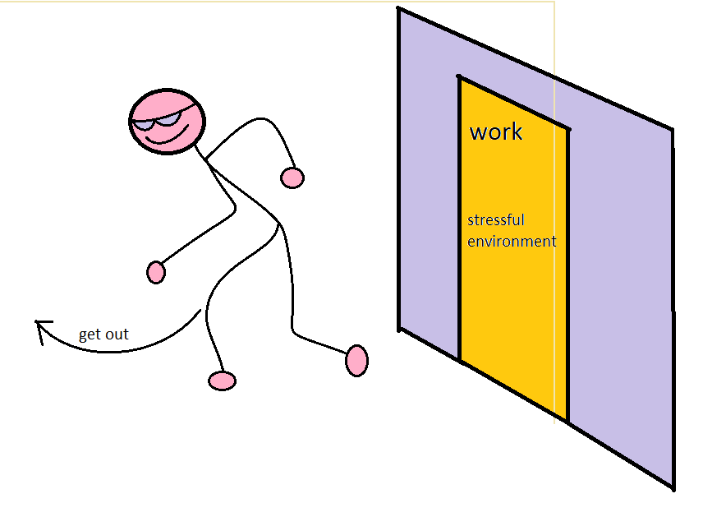
Get away from work and stressful ,environment
Have a chance to be of from work

